Slide 1
Module1: Introduction

Slide 2
A Few Quotes
“A breakthrough in machine learning would be worth ten Microsofts” (Bill Gates, Chairman, Microsoft)
“Machine learning is the next Internet” (Tony Tether, Director, DARPA)
Machine learning is the hot new thing” (John Hennessy, President, Stanford)
“Web rankings today are mostly a matter of machine learning” (Prabhakar Raghavan, Dir. Research, Yahoo)
“Machine learning is going to result in a real revolution” (Greg Papadopoulos, CTO, Sun)
“Machine learning is today’s discontinuity” (Jerry Yang, CEO, Yahoo)

Slide 3
So What Is Machine Learning?
Automating automation
Getting computers to program themselves
Writing software is the bottleneck
Let the data do the work instead!

Slide 4
Traditional Programming
Machine Learning
Data
Computer
Output
Program
Data
Computer
Program
Output

Slide 5

Magic?
No, more like gardening
Seeds = Algorithms
Nutrients = Data
Gardener = You
Plants = Programs

Slide 6
Related Disciplines
decision
theory
game
theory
AI
control
theory
information
theory
biological
evolution
Machine
Learning
probability
&
statistics
philosophy
optimization
statistical
mechanics
psychology
Data Mining
computational
complexity
theory
neurophysiology

Slide 7
History of Machine Learning
1960’s and 70’s: Models of human learning
High-level symbolic descriptions of knowledge, e.g., logical expressions or graphs/networks, e.g., (Karpinski & Michalski, 1966) (Simon & Lea, 1974).
Winston’s (1975) structural learning system learned logic-based structural descriptions from examples.
Minsky Papert, 1969
1970’s: Genetic algorithms
Developed by Holland (1975)
1970’s - present: Knowledge-intensive learning
A tabula rasa approach typically fares poorly. “To acquire new knowledge a system must already possess a great deal of initial knowledge.” Lenat’s CYC project is a good example.

Slide 8
History of Machine Learning (cont’d)
1970’s - present: Alternative modes of learning (besides examples)
Learning from instruction, e.g., (Mostow, 1983) (Gordon & Subramanian, 1993)
Learning by analogy, e.g., (Veloso, 1990)
Learning from cases, e.g., (Aha, 1991)
Discovery (Lenat, 1977)
1991: The first of a series of workshops on Multistrategy Learning (Michalski)
1970’s – present: Meta-learning
Heuristics for focusing attention, e.g., (Gordon & Subramanian, 1996)
Active selection of examples for learning, e.g., (Angluin, 1987), (Gasarch & Smith, 1988), (Gordon, 1991)
Learning how to learn, e.g., (Schmidhuber, 1996)

Slide 9
History of Machine Learning (cont’d)
1980 – The First Machine Learning Workshop was held at Carnegie-Mellon University in Pittsburgh.
1980 – Three consecutive issues of the International Journal of Policy Analysis and Information Systems were specially devoted to machine learning.
1981 - Hinton, Jordan, Sejnowski, Rumelhart, McLeland at UCSD
Back Propagation alg. PDP Book
1986 – The establishment of the Machine Learning journal.
1987 – The beginning of annual international conferences on machine learning (ICML). Snowbird ML conference
1988 – The beginning of regular workshops on computational learning theory (COLT).
1990’s – Explosive growth in the field of data mining, which involves the application of machine learning techniques.

Slide 10
Bottom line from History
1960 – The Perceptron (Minsky Papert)
1960 – “Bellman Curse of Dimensionality”
1980 – Bounds on statistical estimators (C. Stone)
1990 – Beginning of high dimensional data (Hundreds variables)
2000 – High dimensional data (Thousands variables)

Slide 11
What is machine learning?
A branch of artificial intelligence, concerned with the design and development of algorithms that allow computers to evolve behaviors based on empirical data.
As intelligence requires knowledge, it is necessary for the computers to acquire knowledge.

Slide 12

Machine Learning is…
Machine learning, a branch of artificial intelligence, concerns the construction and study of systems that can learn from data.

Slide 13
Machine Learning is…
Machine learning is programming computers to optimize a performance criterion using example data or past experience.
-- Ethem Alpaydin
The goal of machine learning is to develop methods that can automatically detect patterns in data, and then to use the uncovered patterns to predict future data or other outcomes of interest.
-- Kevin P. Murphy
The field of pattern recognition is concerned with the automatic discovery of regularities in data through the use of computer algorithms and with the use of these regularities to take actions.
-- Christopher M. Bishop

Slide 14
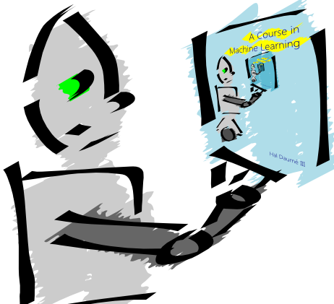
Machine Learning is…
Machine learning is about predicting the future based on the past.
-- Hal Daume III

Slide 15
Machine Learning is…
Machine learning is about predicting the future based on the past.
-- Hal Daume III
past
future
predict
learn
Training
Data
model/
predictor
Testing
Data
model/
predictor

Slide 16
Machine Learning, aka
data mining: machine learning applied to “databases”, i.e. collections of data
inference and/or estimation in statistics
pattern recognition in engineering
signal processing in electrical engineering
induction
optimization

Slide 17
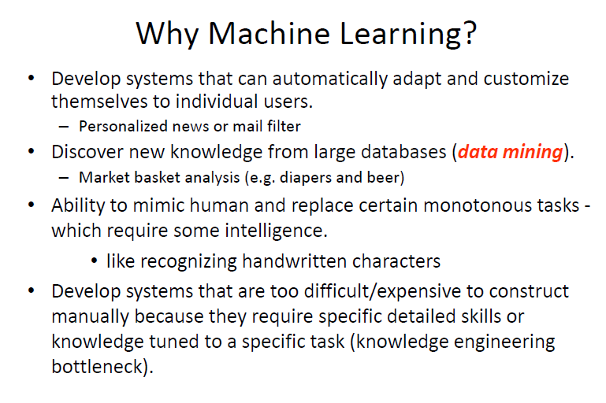

Slide 18
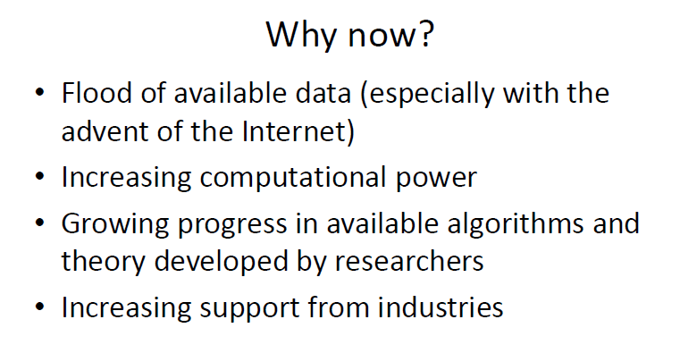

Slide 19
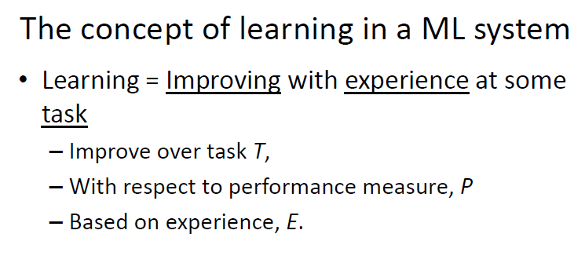

Slide 20
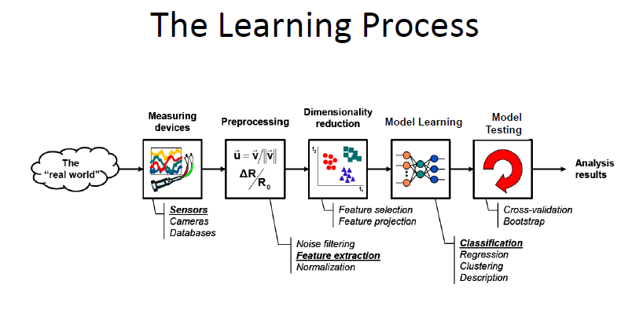

Slide 21
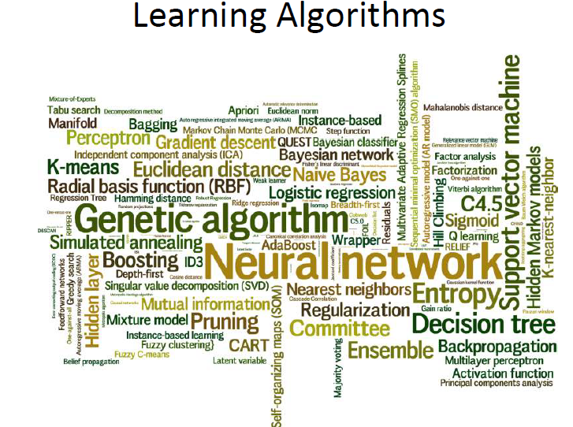

Slide 22
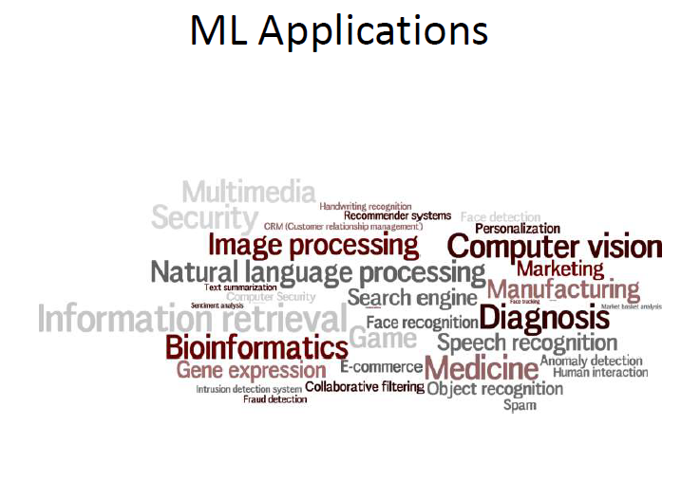

Slide 23
Types of Learning
Supervised (inductive) learning
Training data includes desired outputs
Unsupervised learning
Training data does not include desired outputs
Semi-supervised learning
Training data includes a few desired outputs
Reinforcement learning
Rewards from sequence of actions

